Slide 1
Turning Sunlight into Savings!
Local perspectives on Solar PV in Dublin 7
Tuesday 6th February 2024

Slide 2
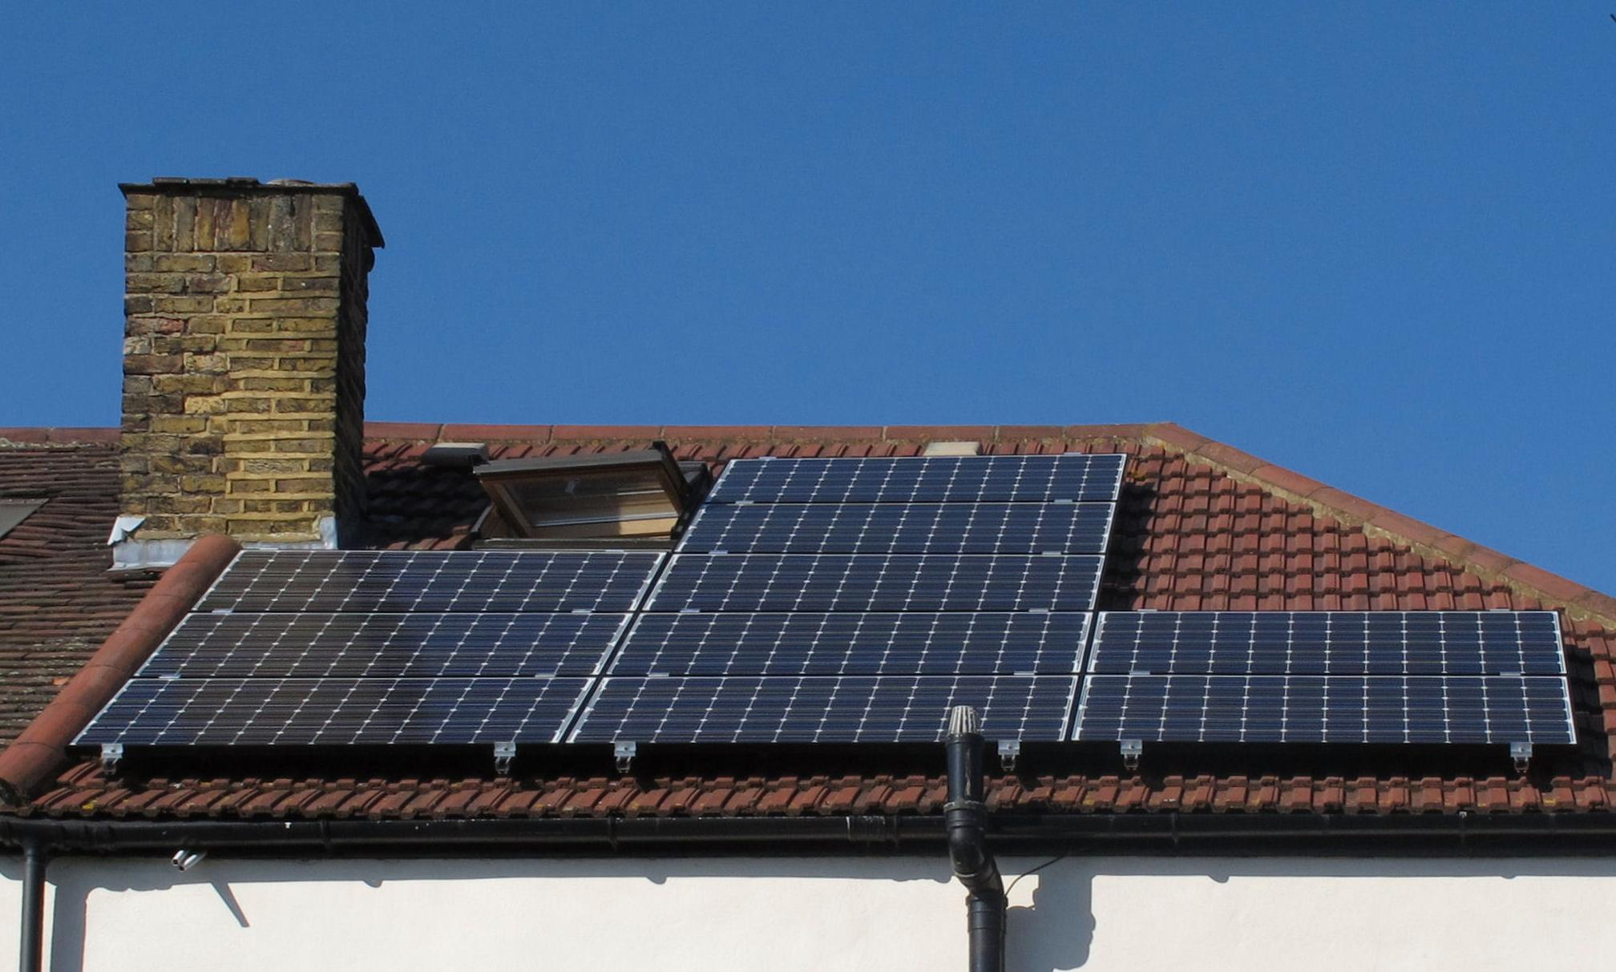
Agenda
Welcome!
Introduction by Ger O’Halloran
Stephanie: Solar in Stoneybatter
Celine: PV in Phibsboro
Eoin & Michelle: Kilowatts in Cabra
Ger Doherty: The Grants!
Q & A
Close
Notes:
Housekeeping: We are recording this webinar. There will be a q and a at the end but feel free to pop your questions into the chat.
Go through the agenda.

Slide 3
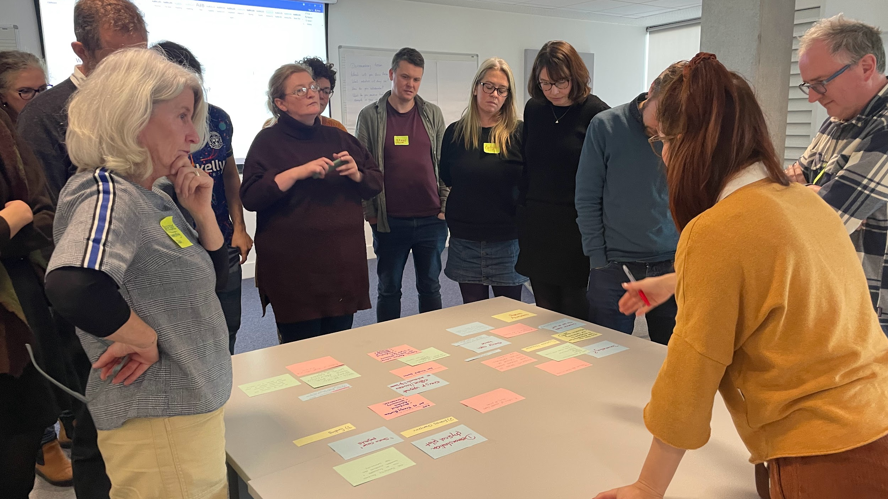
What/Who is the Triple Sec?
Notes:
The what and the how of the triple sec Ger

Slide 4
Who Are We?
A collaboration of three sustainable energy communities in Dublin City, Ireland.
Connecting Cabra, Cosybatter & Phibsboro Sustainable Energy Communities.
We’re volunteers who want to help with the energy transition. We want to move from “Plan” to “Do” with our Energy Master Plans.
Providing knowledge & lived experiences to other members of the community.
Our Goal: Energy Independence

Slide 5
Energy Efficiency
Area | Average Building Energy Rating | Heat Loss
Cabra | E1 | 321 kWh/m²/yr
Phibsboro | E2 | >340 kWh/ m²/yr
Stoneybatter | E1 | 330 kWh/m²/yr

Slide 7
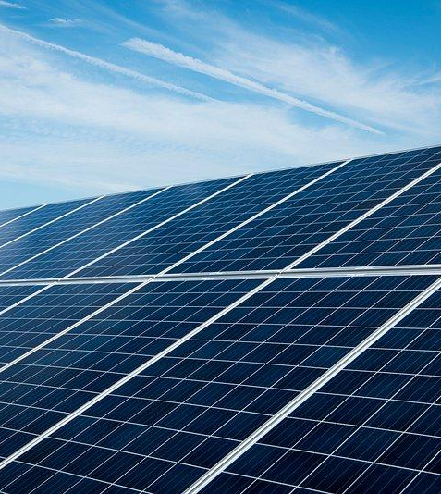
Solar in Stoneybatter
Stephanie Dickenson

Slide 8
SOLAR IN STONEYBATTER

Slide 9
COSYBATTER
Cosybatter is Stoneybatter’s “Sustainable Energy Community”.
Aims:
Find out what our energy use is.
How we might reduce that energy use.
How we might move to more renewable energy sources.
Reasons:
To save money.
To make our buildings more comfortable.
To help with Climate Change.
Contact us: cosybatter@gmail.com

Slide 10
SOLAR COTTAGE
I had a basic solar PV system installed in August 2021 on this typical Stoneybatter cottage.
This roof is south/south-west facing, so good for capturing the sun’s light.
This was installed by Caldor Solar.
This is a system of x4 380 watt panels.

Slide 11
INSTALLATION
The install was very quick, with minimal disruption.
A team worked on the internal electrics including in the (typically) small cottage attic, and then others on the roof installing the PV.
The system started working immediately, generating electricity that afternoon.

Slide 12
ENERGY GENERATED
1500
This solar PV has consistently generated 1500 kilowatt-hour (kWh) each year – despite some variable weather conditions!

Slide 13
PV in Phibsboro
Celine Reilly

Slide 14
Climate Club Phibsboro Village Tidy Towns
Céline Reilly,
Solar PV
Tuesday 6th February 2024
https://www.phibsborovillage.com/tidy-town

Slide 15
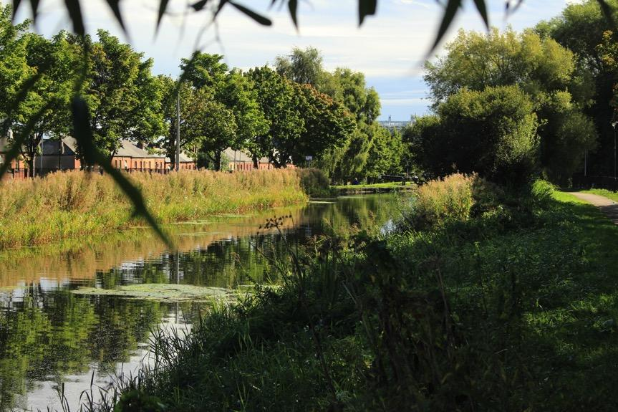
Phibsboro Village Climate Club: Journey to Date
Energy Masterplan
North Circular Economy
Biodiversity Action Plan
Partnerships
Decarbonisation Zone
Public Sector within SEC

Slide 16
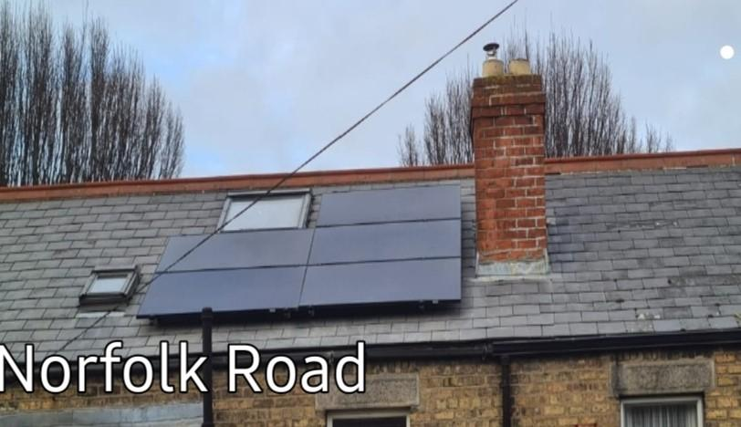
Solar PV in Phibsboro: Norfolk Road mid terrace Background
Context:
Mid Terrace 3 bed redbrick,
South facing rear roof with large Velux
2 full time occupants, one working from home, one retired.
Electricity usage pre-solar: 2664 units ( €910 at 0.2per unit).
Gas Usage pre-solar: 10291 units, (€874 @0.55per unit)
Research:
Checked the SEAI page for approved suppliers and grant information
Spoke with friends who had installations( biggest influence)
Got a BER survey ( E1) and checked bills
Checked facebook – Irish Solar Owners Group
Got 2 quotes, both made site visits and were helpful and informative
Decision: 5 panels, Eddi, and no battery
Process:
Placed order with Byrne energy, so efficient,
Deposit: 25% - €1375
Byrne Energy dealt with the grant - €1680
Total paid: €3820.
Roofers: Half day
Electrician: half day
Very little disruption

Slide 17
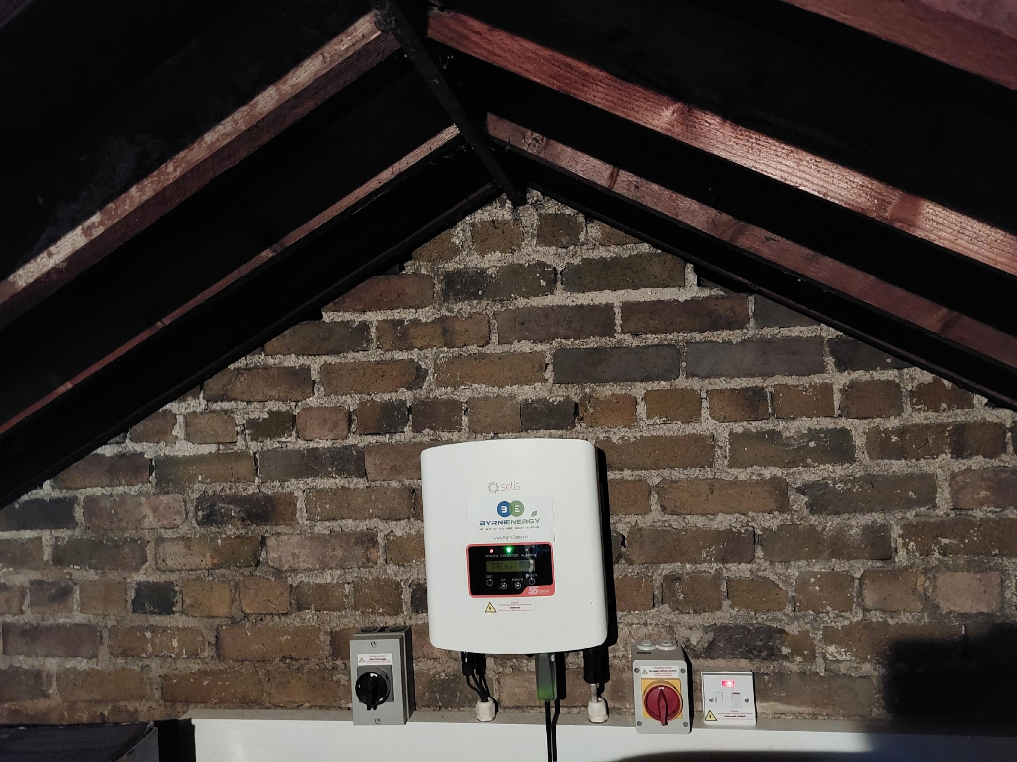
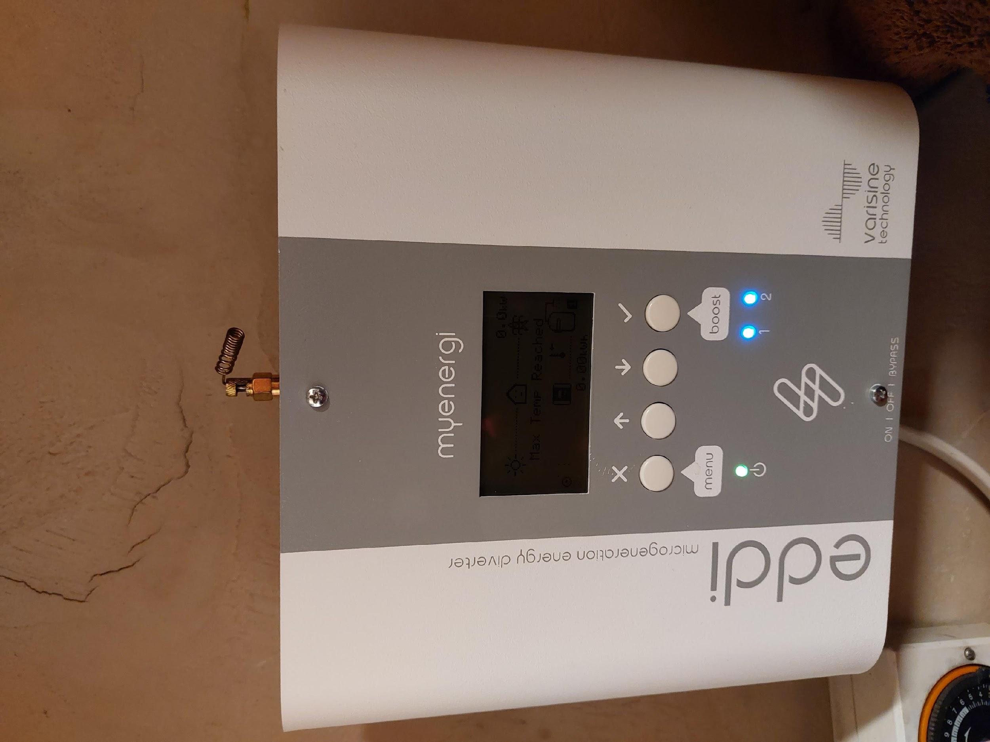
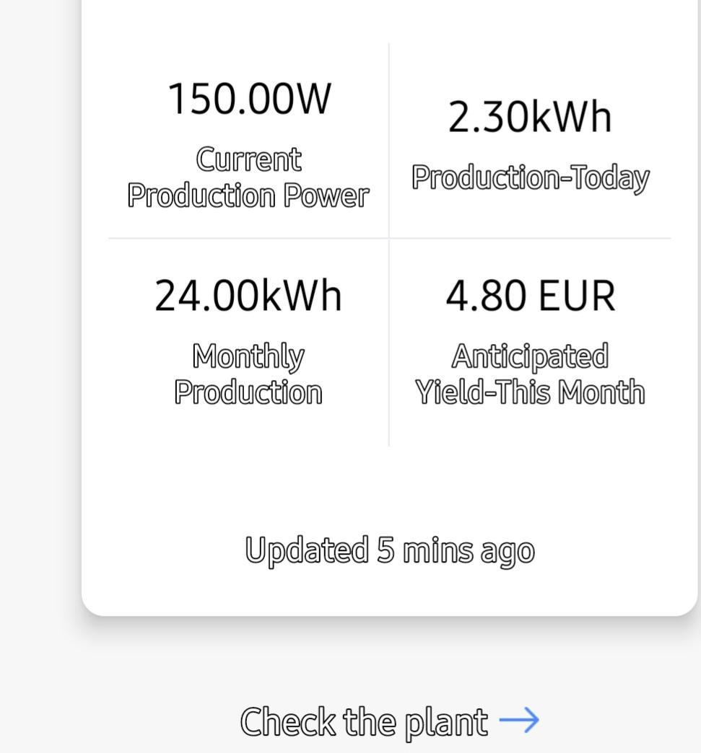
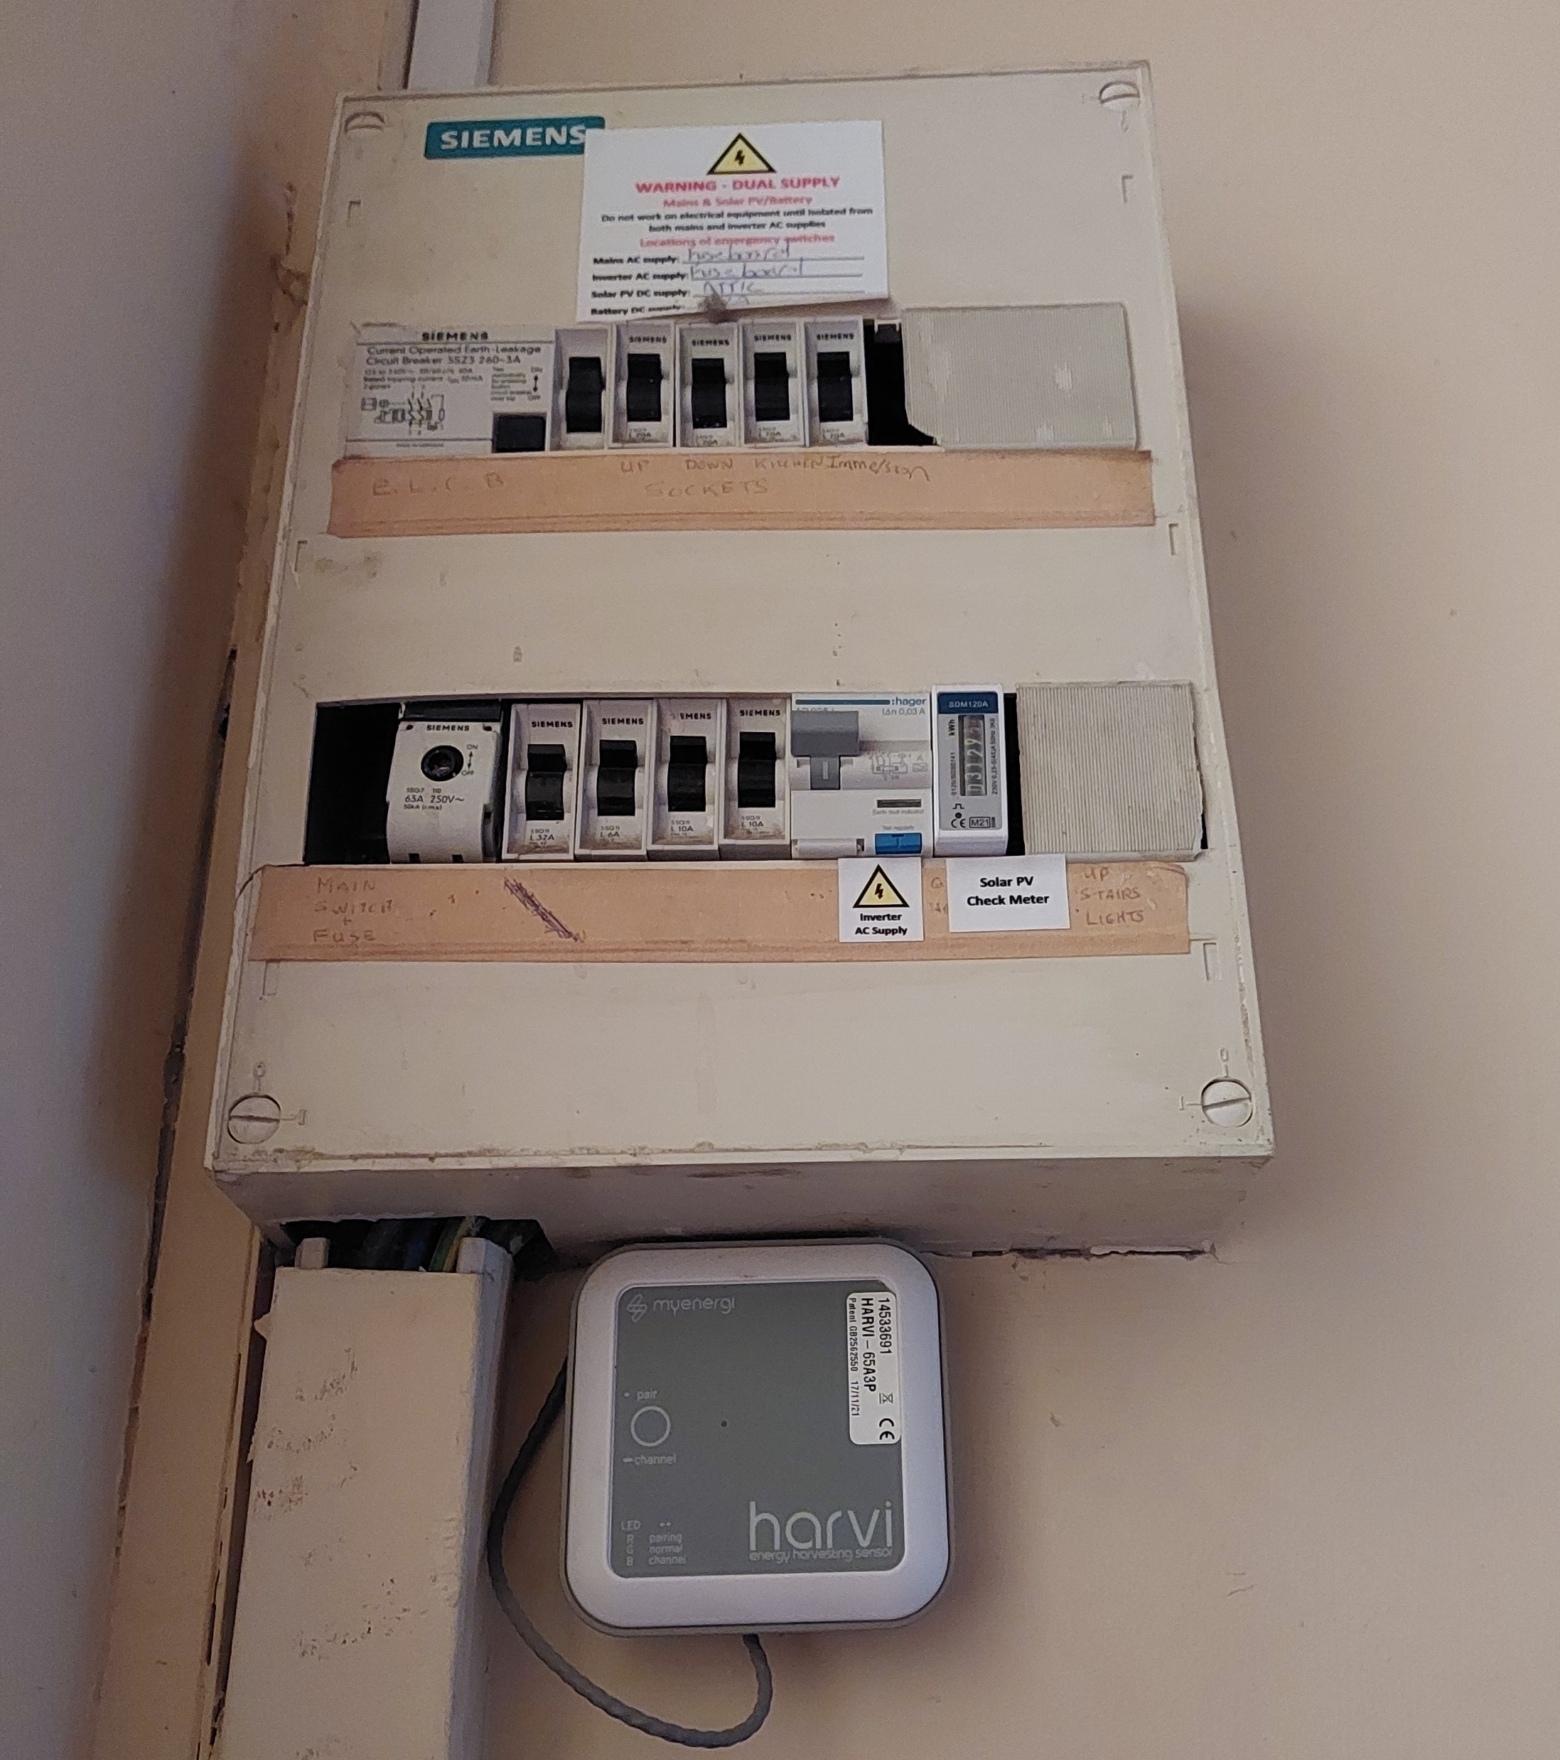
Solar PV in Phibsboro: Norfolk Road mid terrace Technical Information
Supplier: Byrne Energy
Plant:
5 x Q-Cells 375W solar panels
Solis S5 series Inverter in attic
Eddi Hot Water Diverter
Harvi: Facilitates wireless connection rom Eddi
App: Solarsmart App
Smart Meter

Slide 18
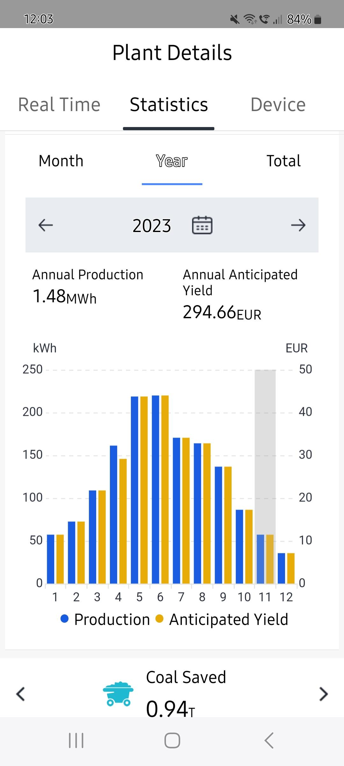
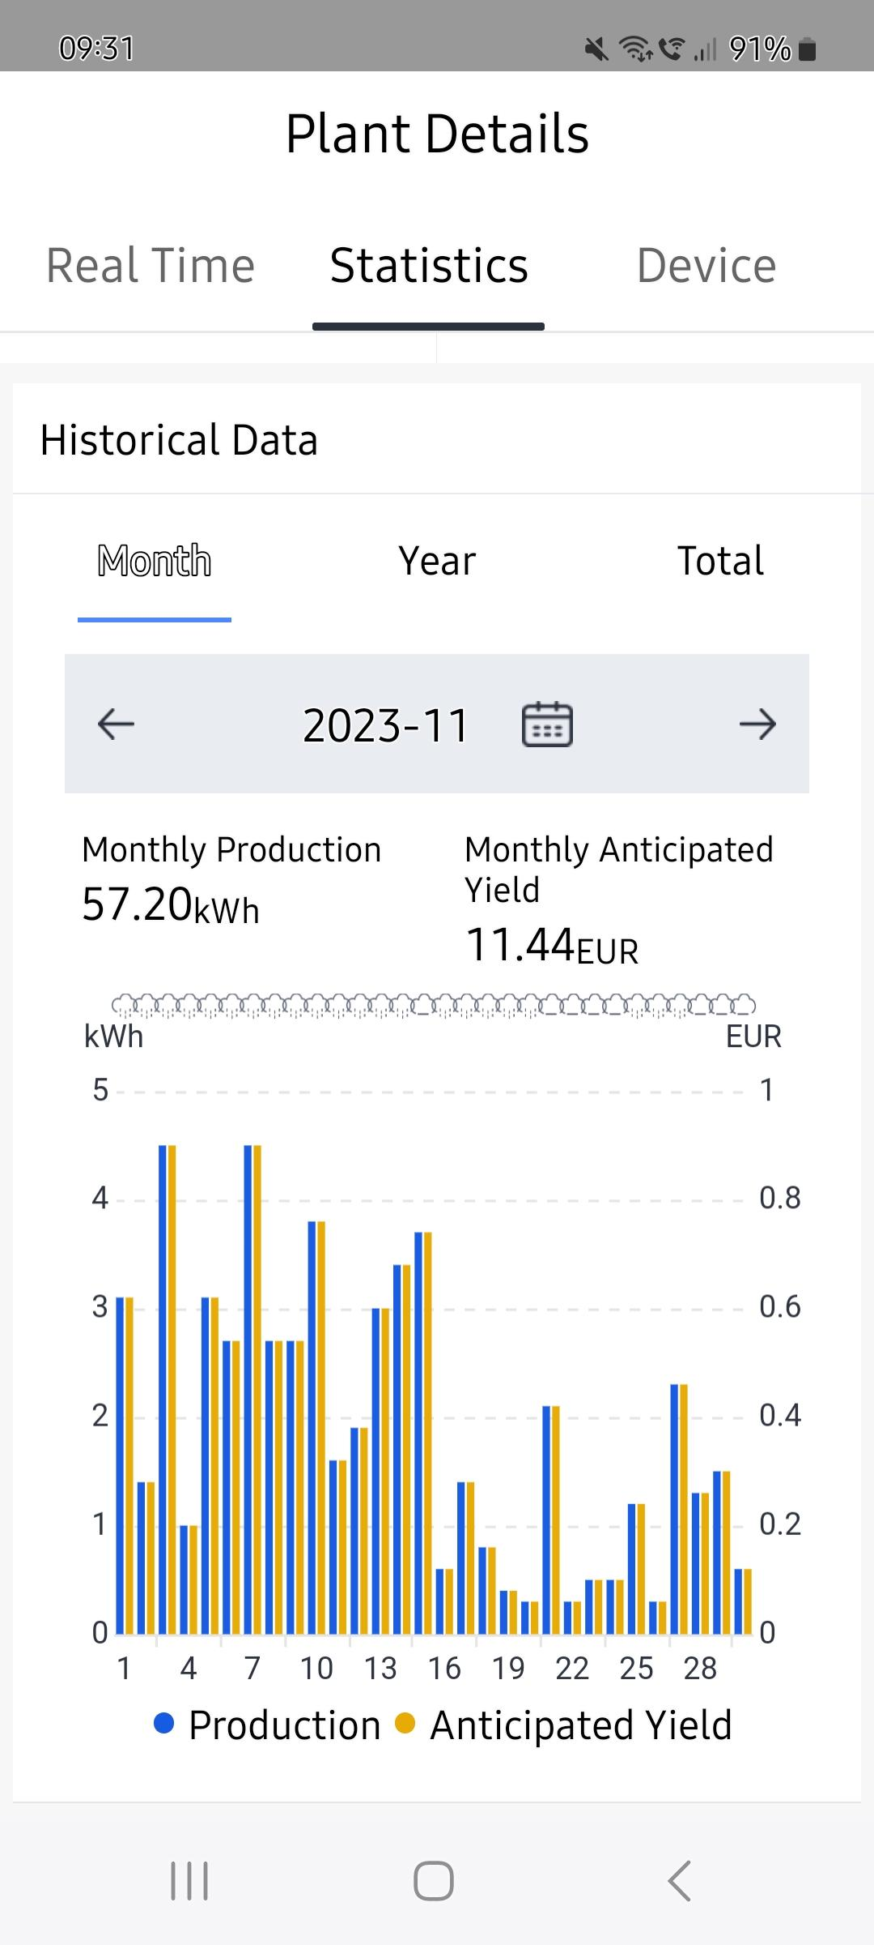
Solar PV in Phibsboro: Norfolk Road mid terrace Generation and Usage
Annual Usage:
Electricity pre-solar: 2664 KWh per annum
Electricity Post-Solar: 1197 KWh per annum
Gas Pre-solar: 10,291 units per annum
Gas post-solar: 4221 units per annum
Average Daily Usage :
Nov/Jan Bill
Pre-solar: 6.9KWh
Post-Solar: 4.8KWh
July/Sept Average Bill
Pre-solar: 4.8KWh
Post-Solar: 2.6KWh
Energy Generated in 2023: 1480KWh
Behavioural Change: Monitor usage, only use high usage appliances when we have solar light, no gas used for water heating in summer months, turn Eddi off when we go on holidays
Notes:
.

Slide 19
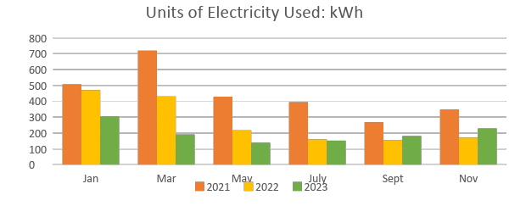
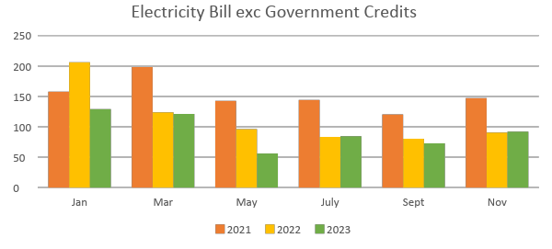
Solar PV in Phibsboro: Norfolk Road mid terrace Financial Information
Cost of the panels
Total installed cost of 5 panels/electronics €5500
Less SEAI grant -€1680
Net amount paid € 3820
Solar power generated in 2023
Solar generated 1480KWh
Sold back to grid : 415KWh
Solar power displacing grid import 1065KWh
Savings from Solar per annum
Value of free power:1065*0.4444: €474
Surplus energy sold back €75
Payback: Solar savings/lower gas bills/Government credits/

Slide 20
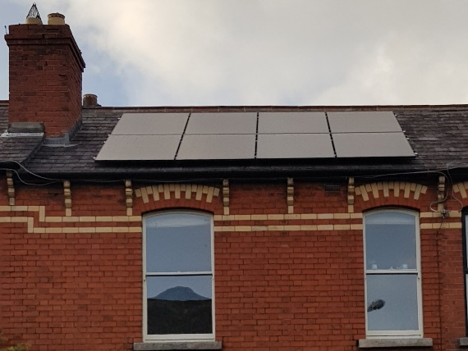
Solar PV in Phibsboro: Shandon mid terrace Technical Information
Supplier: Alternative Energy Ireland (after 3 quotations)
System:
16 X Longi 405W 54 cell HI-MO5 All Black solar panel
AEI Solis 6kW dual-string inverter & SolisCloud app
Eastron SMD120A single phase Energy Meter Eddi V2.1 Immersion Controller & myenergi app
4 X Tico Opmisers
Performance: Solar energy generated in year: 4,625 kWh

Slide 21
Solar PV in Phibsboro: Shandon mid terrace Financial Information
Cost of the panels
Total installed cost of 16 panels/electronics €12,310
Less SEAI grant -€ 2,400
Net amount paid (incl. VAT of ~€1,300) € 9,910
Savings from Solar per annum
Value of free solar electricity €480
Surplus solar electricity sold back to grid €554
Total € 1,034
Rate of Return
Savings/Cost x 100% 10.4% p.a.
Net Present Value (NPV) NPV is used in capital budgeting and investment planning to analyse the proﬁtability of a projected investment or project. Rule of thumb is that investment should be made only when NPV is positive.
Guaranteed lifetime of panels 25 years
Guaranteed lifetime of inverter circuit 10 years
NPV @ discount rate of 4% € 4,909
NPV @ discount rate of 6.5% € 1,800
Details of savings for the year
Nominal cost of electricity for the year €1,450
Value of free solar electricity €480
Surplus solar electricity sold back to grid €554
Switching supplier. 10% discount €110
Government Electricity Credit: 2 X €200 in 2023 €400
Total savings for year €1,544
Opening balance Nov 22: €21cr
Closing balance Nov 23: €115cr

Slide 22
Solar PV in Phibsboro: Shandon Mid terrace Environmental Value
Electricity in Ireland is generated from a mix of fossil fuels (Coal, oil and gas) and renewables (solar, wind). Fossil fuels emit carbon dioxide (CO2), which is a greenhouse gas causing global warming and climate change.
Solar energy generated in ﬁrst year 4,624 kWh
CO2 per kWh (EPA data for 2022) 345 grams/kWh
Total CO2 saved in year (4,624 x 345) 1.6 tonnes CO2
Monthly solar energy
Jan – Nov 2023
(Note effect of sunny May and cloudy July)

Slide 23
Solar PV in Phibsboro: Norfolk Road mid terrace Takeaways
It is worth getting solar even if you have not carried out other retrofitting measures
It is worth getting solar even of you can only fit 5 panels
The grant and installation process are not complicated
Don’t underestimate the satisfaction you get from powering your washing machine and other appliances from the sun!
Even in Winter you get power from the panels
Even when you are away, they are working for you and sending power to the grid
Would I do anything differently? Given our circumstances probably not.

Slide 24
Kilowatts in Cabra
Eoin Condron and Michelle Nolan

Slide 25
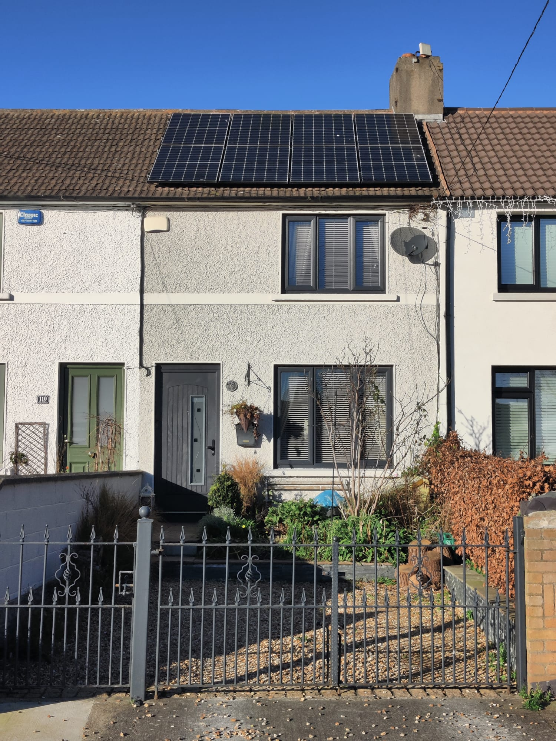
Photo of panels on roof
Solar panels covering the full roof.
The house is facing East to West, so it gets the sun most of the day.
Notes:
Typical size of house in Cabra. We were able to get 8 panels installed. The cost at the time was €8,800 without a battery. The grant of €1,800 brought it down to €7,000. The grant was applied for by the solar company while they were in my house. The black pipe to the left of the picture are the cables going into my attic.

Slide 26
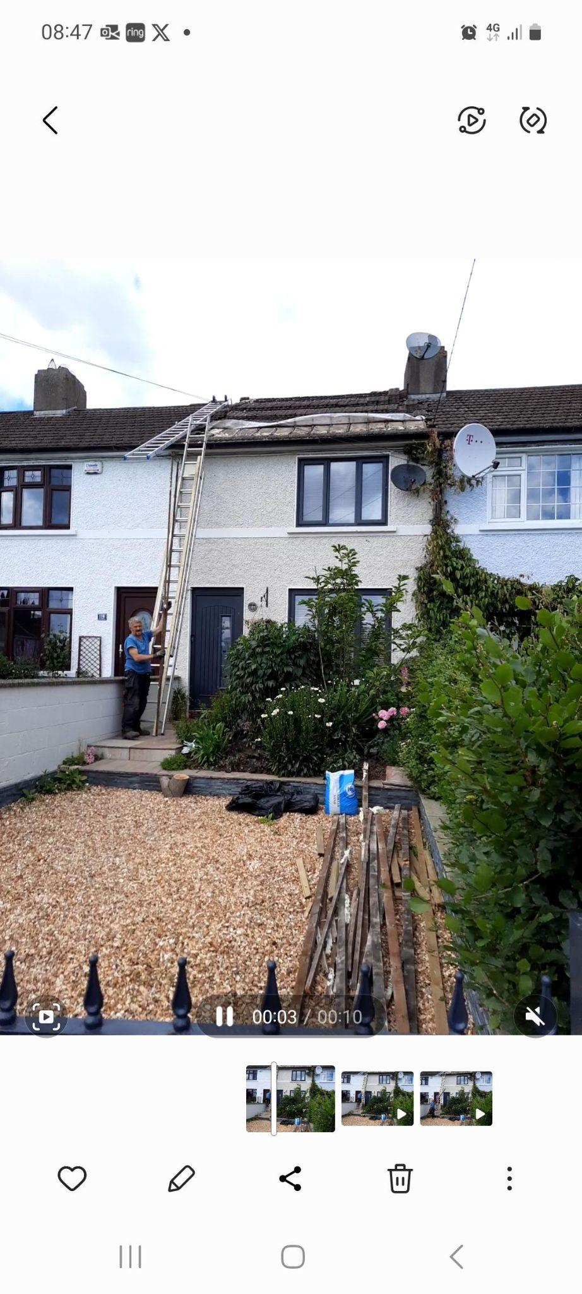
Membrane
Most houses in Cabra have the roof tiles straight onto the rafters, so before the works commenced, a membrane had to be installed.
It was an added expense of €1,500 but had to be done so that the solar panels would not dislodge when fitted.

Slide 27
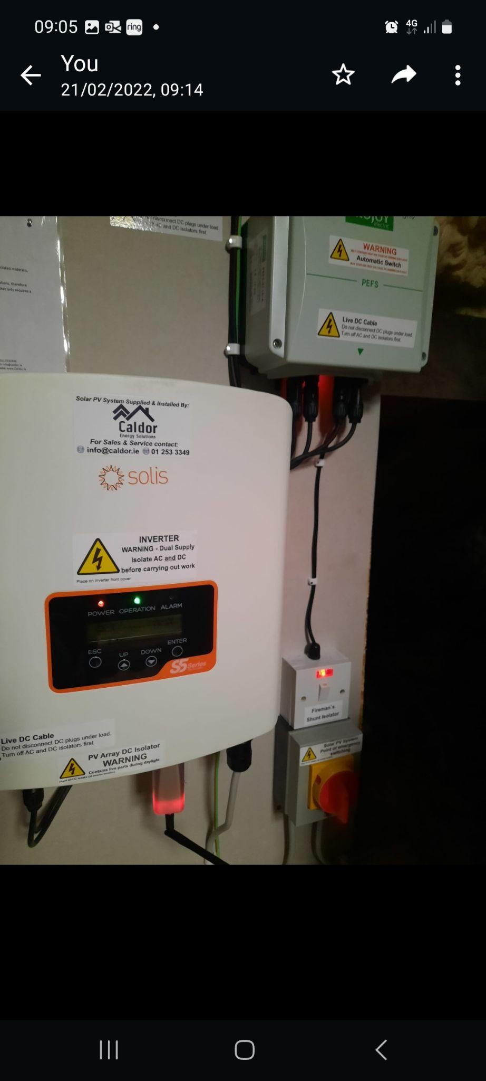
The inverter
This is a photo of what's in the attic. It's just one panel and not in any way obtrusive.
If I don't use all of the generated electricity, then it goes into heating the water.
There is also a small panel in the hot press where I can boost the hot water if needed.

Slide 28
My lovely meter
This is a photo of my meter of which I still have. When the panels are creating energy, my meter goes backwards and turns the dial.
At this time of year, I get to use what I have created in the summer and use in the winter. This is especially beneficial as I have removed my gas central heating and converted over to electricity which I would not have been able to do with the panels being installed.

Slide 29
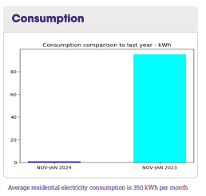
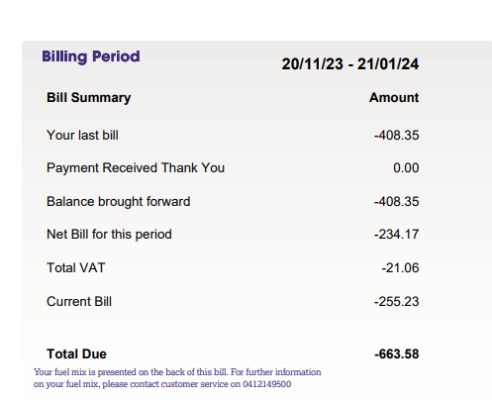
Benefits of Solar Panels in real terms.

Slide 30
PV System in Cabra Drive
4.5 kW System (11 Panels)
Installed by Keltic Renewables, along with a heat pump. Initially engaged with the One Stop Shop scheme(rs) House2Home but found their quotes exorbitant. Switched to single measure grants with Keltic. More work but saved 40% on the quote.
The house is now A2 rated
Zappi car charger diverts the excess to the car when plugged in

Slide 31
Cost / Benefit
Cost:
€7,900 for equipment and Panel installation
€1,200 for electrics (electrician hired separately)
Approved for grant of €2,400 pending inspection
Net €6,700
Installation completed in June so still uncertain of benefit. Heating electrified since last winter so consumption not comparable
From SEAI: A home solar PV system sized at 20 sq. m (~3kW) and well located would generate around 2,600kWh of electricity a year. That is over 40% of the average annual electricity demand of an Irish home.
4,000kWh equates to approx.
€960 per annum at the feed-in tariff rate
€1600 per annum at my current unit charge

Slide 32
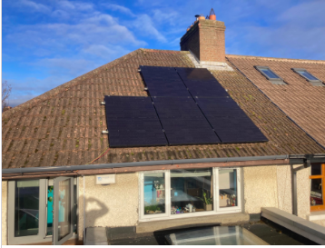
Standard Panels
Five panels on the original roof, facing southwest.
Would have liked more but they
had to be .5 metres from the boundary.
Roofing installation was very smooth,
taking a single day.
Electrics took a few visits (my own fault for
not using their electricians).

Slide 33
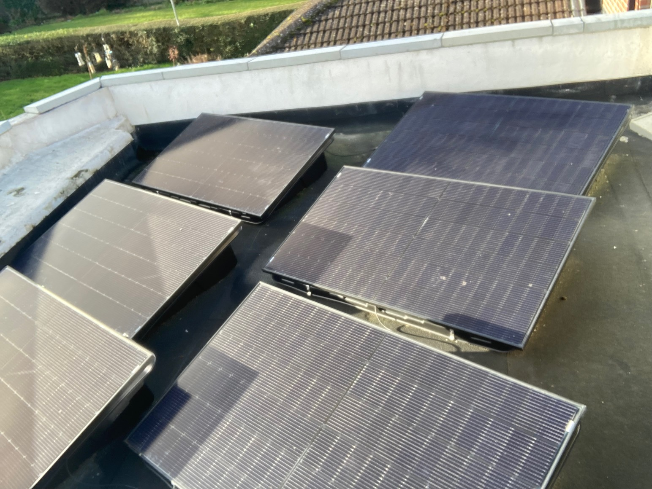
Flat Roof Panels
Six of the panels are laid on the
flat roof in special tilted boxes.
They are facing directly south.

Slide 34
Money, Money, Money….
And Grants!
Gerard Doherty

Slide 36
Where to apply for the grant
https://www.seai.ie/grants/home-energy-grants/solar-electricity-grant/

Slide 37
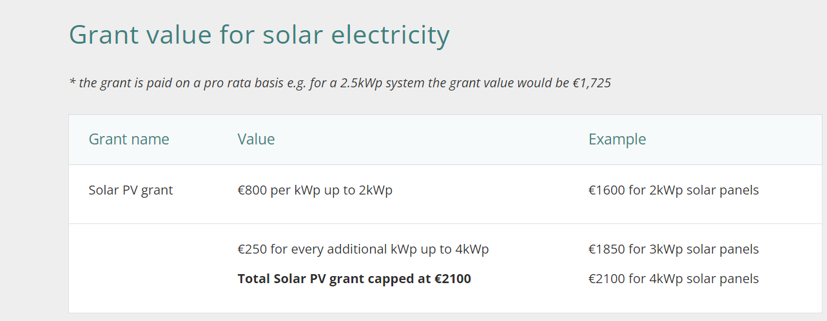
Grant Value

Slide 38
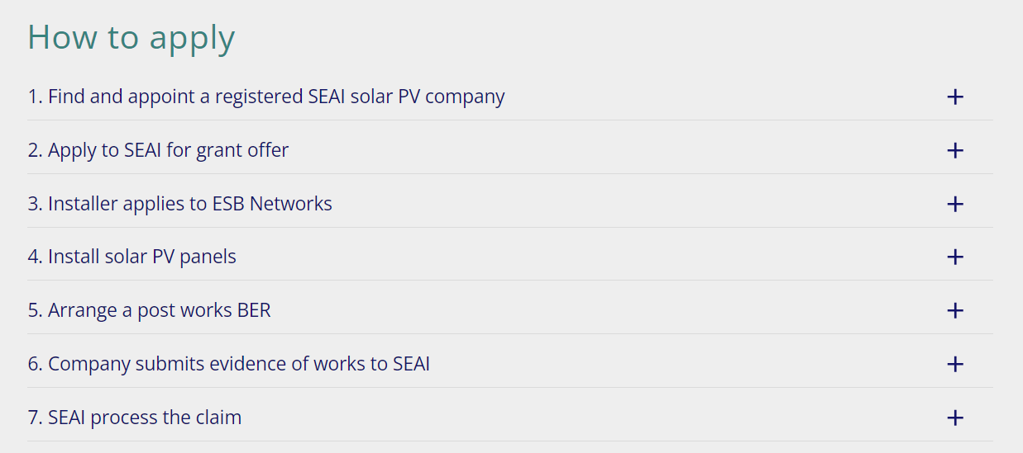

Slide 41
Application Guide

Slide 42
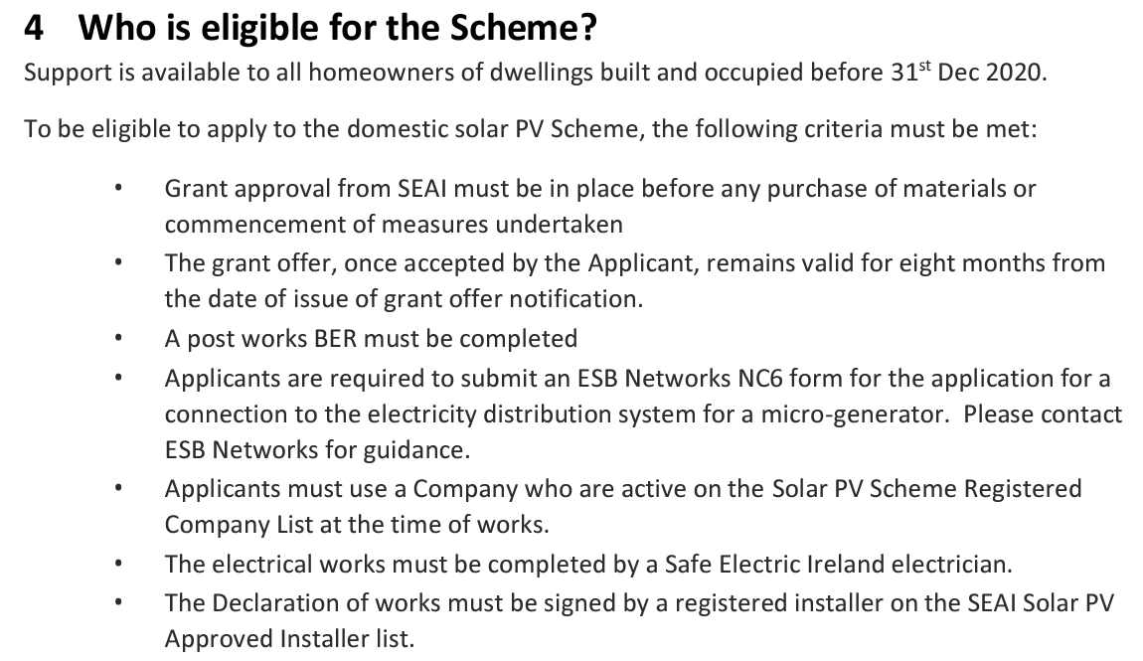

Slide 43
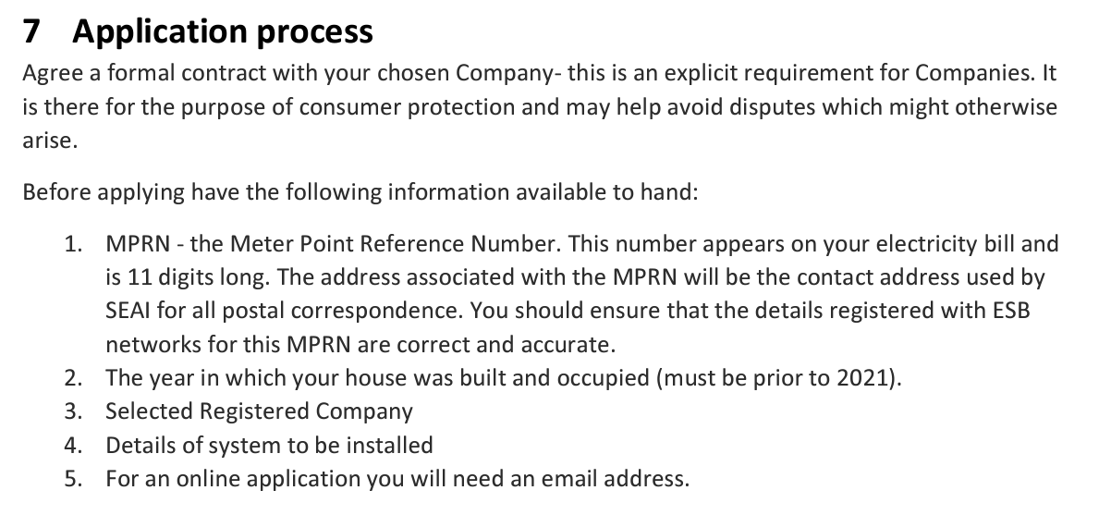

Slide 45
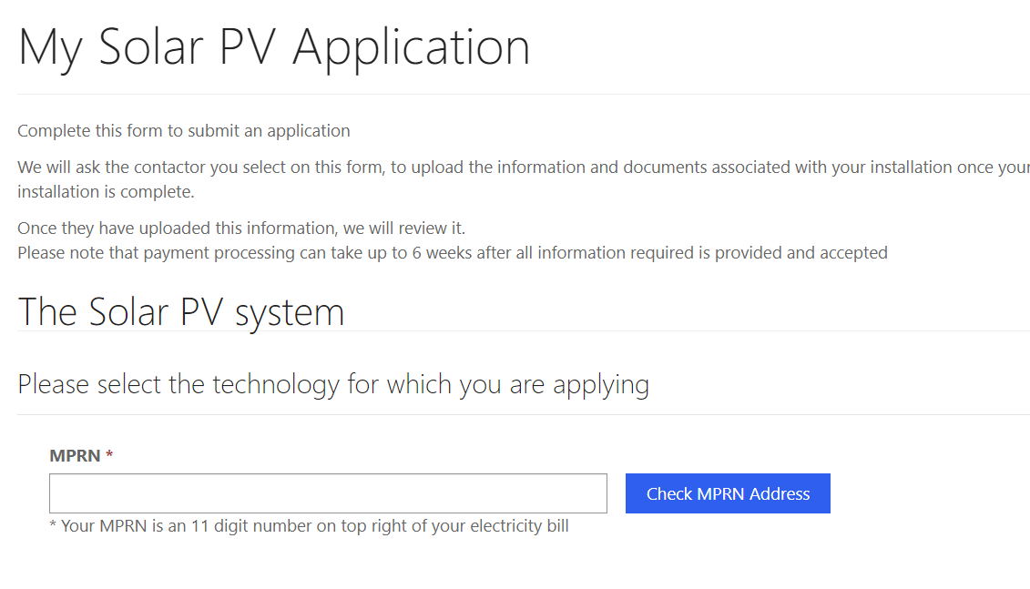

Slide 46
Questions?

Slide 47
Questions and Answers

Slide 48
Thank you for listening!
www.connectingcabra.ie
hello@connectingcabra.ie
Social Media: @ConnectingCabra
cosybatter@gmail.com
Social Media: @Cosybatter
www.phibsborovillage.com
Twitter: @PhibsTidyTown
Facebook: @PhibsboroTidyTown
Instagram: @PhibsboroVillage

